Slide 1
Types of Entrepreneurship
Techno- entrepreneurship
Women entrepreneurship
Social entrepreneurship
Intrapreneurship
Rural entrepreneurship
Family entrepreneurship

Slide 2
Techno-entrepreneurship
In this era of technology, a technopreneur begins their business with nothing but with a brainstorming idea. He identifies present practices and assesses some new ideas to do something different. A person who is engaged in technopreneurship creates a product or solution that uses technological solutions to change the way of doing something in an orthodox way. It improves how we have done something before and how it has to be done in the coming future.

Slide 3
Technology entrepreneurship – or techo entrepreneurship – is something every aspiring entrepreneur needs to know about.
From facebook to Google, and Skype to Snapchat, tech entrepreneurs, have fostered entirely new ways of creating value and doing business – whilst also creating entirely new industries of their own!
As a result, the tech-sector has become one of the most important sectors of many developed nations around the globe. A sector that creates huge investment and plenty of economic benefit – not to mention the positive impact it has on peoples lives.

Slide 4
Technology Entrepreneurship – The Impact We all know facebook, twitter and google – some of the great examples of tech entrepreneurship.
Companies like these have created new industries all on their own, creating billions of dollars of value, boosting economies in the countries from which they grow.
Through tech-entrepreneurship comes investment and jobs.
Through investment and jobs comes greater competitive advantage on an international scale, which in turn attracts more even investment which can be used to further develop the nation.
Countries like Israel, for example, have enjoyed great economic growth ,thanks to their tech talents.

Slide 5
Impact of tech entrepreneur
The Impact so in addition to social media, thanks to tech entrepreneurs, we can now enjoy things like:-
Access to global markets and talent – through things like alibaba.
Work on the go wherever we are – through things like smart phones and tablets.
The ability to connect around the globe with ease through things like Skype and Google Hangouts.

Slide 6
What is Tech Entrepreneurship?
It’s just like ‘normal’ entrepreneurship, except with a particular focus on opportunities that require, or become amplified by, technology.
So this means that tech entrepreneurs spot and identify opportunities in much the same way as others, and essentially go about developing solutions in much the same way too. The big difference is that they utilise and rely on their unique ‘tech’ skill sets to create their competitive advantage.

Slide 7
Elements of Successful Tech -Entrepreneurship
Need to create Unique Value – These days, many people strive to solve the same problem or offer the same value. As a result, particularly in the tech field, creating truly unique value is of critical importance. As soon as a customer sees something they’ve seen before, it’s probably not long before they’re not your customer anymore!
stay up-to-date – Not only with the way that value can be delivered, but also the type of value that’s actually demanded. There’s no point doing something unique that is outdated, or something that’s outdated, that is unique! And when it comes to tech, it’s not long before things are outdated - so this is a particularly important consideration.

Slide 8
Get the right people – Because more so than other ventures, tech ventures need talented people who not only have the technical smarts to create the unique, ever-evolving value required, but also a commitment to growing companies – and this is a hard balance to find.
size of the target market - Thanks to all the requirements of staying unique and up-to-date with uniquely talented and clever people, tech-ventures can be very expensive. Therefore, having the ability to sell to hundreds of thousands of customers, or even millions of customers, is important – especially when investors are involved. Thankfully, unlike services, for example, the cost of serving one thousand customers and the cost of serving one MILLION customers, isn’t very different, which means profit grows rapidly and makes all the risk and investment worthwhile… Assuming you do a good job.

Slide 9
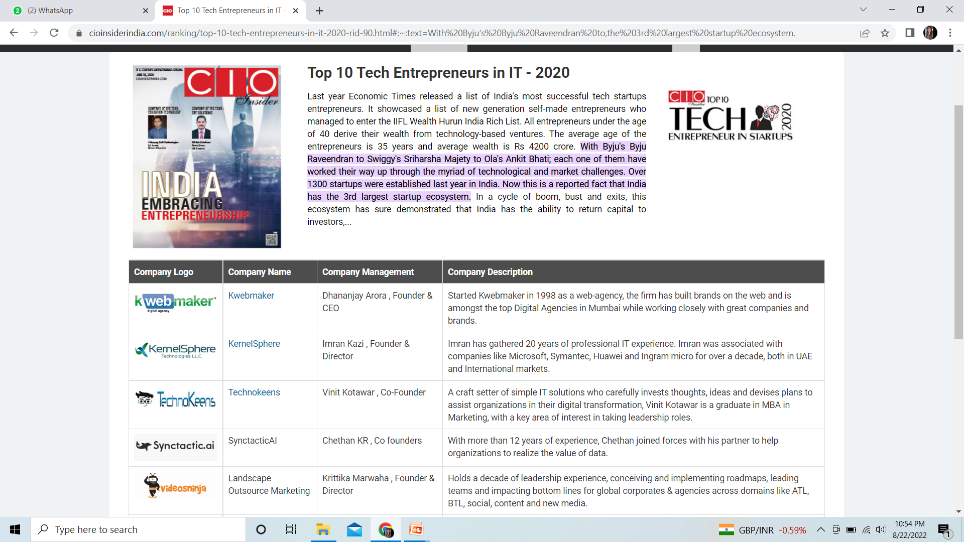

Slide 10
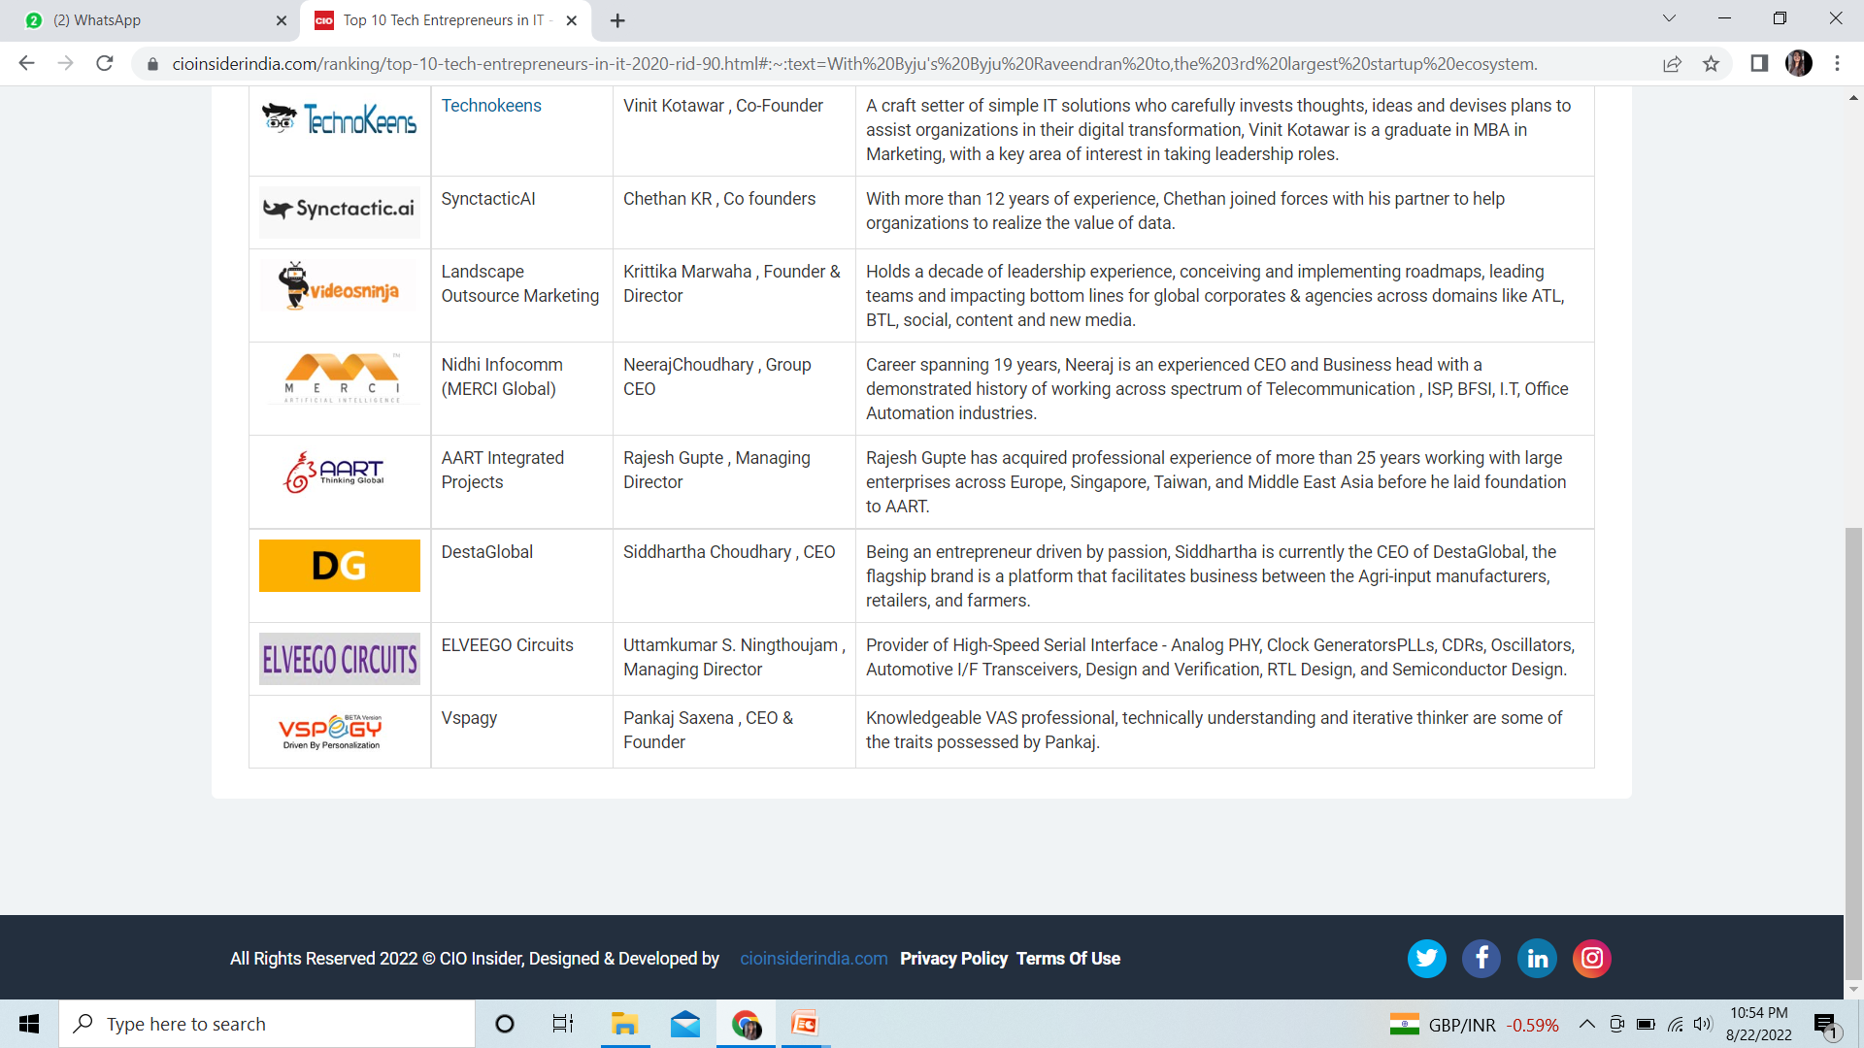

Slide 11
Women entrepreneurs
Women entrepreneurs may be defined as a woman or a group of women who initiate, organise and run a business concern.
Women entrepreneurs are those women who think of a business enterprise, initiate it, organise and combine factors of production, operate the enterprise and undertake risks and handle economic uncertainty involved in running it.
“ An enterprise owned and controlled by a women having a minimum financial interest of 51% of the capital & giving at least 51% of the employment generated in the enterprise to women”.

Slide 12
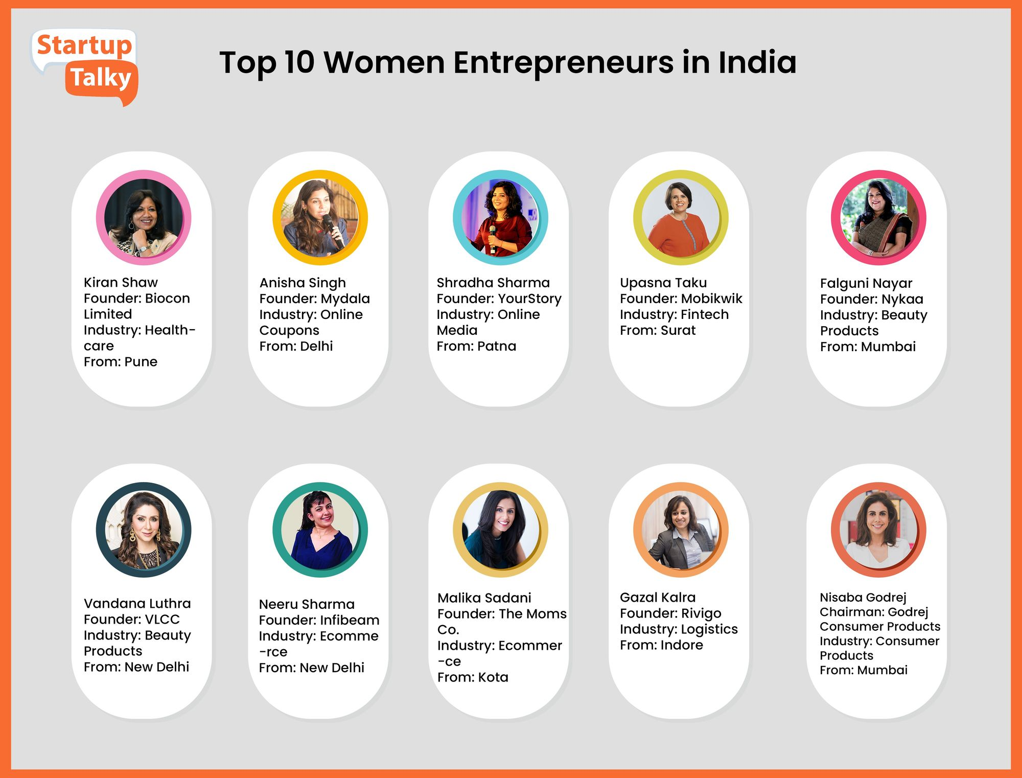

Slide 13
“Somebody once said, educate a woman & u will educate a family.” But the new saying is empower a woman to become an entrepreneur, & you will create an entire family of entrepreneurs. Women entrepreneurship is the need of the nation right now, it is the surest quickest way to make INDIA a super power.

Slide 14
Challenges faced by women entrepreneurs
Microsphere- Mainly confined to the local environment and obliged to live close to the family.
Mesosphere- Work at a regional or national level.
Acts as a barrier when providing assistance to them within this environment.
3. Macrosphere- working at global level

Slide 15
Why women becomes entreprenure
To become economically independent
To establish their own enterprise
To establish their identity in society
To achieve Excellence
To build confidence to themselves
To develop risk assuming ability
To claim equal status in society
To secure greater freedom & mobility Liking for business
An urge to do something new

Slide 16
Strategies for the development of women entrepreneurs
Encouraging home-based business
Widespread business education(Workshops, conferences, training…)
Better financial assistance(venezuelas women development bank)
Wider access to technology(With the help of internet)

Slide 17
Problems faced by women entrepreneur
Male dominated society
Lack of business information
Low risk taking ability
Lack of education
Lack of family support

Slide 18
Government incentives
Mahila Vikas Nidhi
District industries center
Rashtriya Mahila Kosh

Slide 19
Mahila vikas nidhi
Under Mahila vikas nidhi, a cumulative help of Rs. 80.4 million was sanctioned, during the period 1990-2001 . Various training- cum production centers set up by NGOs mostly relate to activities like spinning, weaving, block printing, handloom products, handicrafts etc.

Slide 20
District industries center(DICs)
DICs arrange various lectures and seminars etc. In girls colleges and technical institutes to encourage them to set up their own enterprises.

Slide 21
Rashtriya Mahila Kosh
It was set up in 1993 to provide micro- credit to poor women who had no access to financial institution at reasonable rates of interest with very low transaction costs and simple procedures. It proved quite useful for lower income group women.

Slide 22
Institution supporting Women Entrepreneurs in India- Pg 132
Consortium of women entrepreneurs of India(CWEI)
Federation of Indian women entrepreneurs(FIWE)
FICCI Ladies organization(FLO)
Women's India trust(WIT)
Association of women entrepreneurs of Karnataka(AWAKE)

Slide 23
Social entrepreneurship
Social entrepreneurship is the process by which individuals, startups and entrepreneurs develop and fund solutions that directly address social issues. A social entrepreneur, therefore, is a person who explores business opportunities that have a positive impact on their community, in society or the world.

Slide 24
Social entrepreneurship is the process of recognizing and resourcefully pursuing opportunities to create social value . Social entrepreneurs are innovative , resourceful, and results oriented. They draw upon the best thinking in both the business and non-profit worlds to develop strategies that maximize their social impact.
These entrepreneurial leaders operate in all kinds of organizations : large and small; new and old; religious and secular; non-profit, for-profit, and hybrid. These organizations comprise the ‘social sector’.

Slide 25
For-profit entrepreneurs typically measure performance using business metrics like profit, revenues and increases in stock price. Social entrepreneurs, however, are either non-profits, or they blend for-profit goals with generating a positive "return to society“
Social entrepreneurship typically attempts to further broad social, cultural and environmental goals often associated with the voluntary sector in areas such as poverty alleviation, health care and community development.

Slide 26
social entrepreneurship Drivers
Social issues inadequately addressed by government.
Need to raise funds for charities.
Changing public sector.
budget cuts require new revenue streams
change rather than good stewardship (taking care organisation) leads to promotion .
Growing demand for corporate social responsibility and ethical entrepreneurship

Slide 27
For example, an organization that aims to provide housing and employment to the homeless may operate a restaurant, both to raise money and to provide employment for the homeless.

Slide 28
Social Entrepreneurship holds the key for future development in India. In the days to come, social entrepreneurs will play a crucial role in the advancement of social changes. The best thing about social entrepreneurship is that success is not mentioned by financial gains, but by the number of people these enterprises are able to reach and create a positive impact. In the coming days, social entrepreneurship and Social businesses will be in the mainstream substantially, which will hopefully impact the society positively.

Slide 29
Intrapreneurship
Intrapreneurship is Becoming an Entrepreneur on the Job.
Intrapreneur- A person within a large corporation who takes direct responsibility for turning an idea into a profitable finished product through assertive risk taking and innovation.
Intrapreneur have entrepreneurial skills blended with managerial skills but operate within the confines of an organization.
Entrepreneur refers to a person who set up his own business with a new idea or concept. Intrapreneur refers to an employee of the organization who is in charge of undertaking innovations in product, service, process etc.

Slide 30
An intrapreneur is an employee who is tasked with developing an innovative idea or project within a company. The intrapreneur may not face the outsized risks or reap the outsized rewards of an entrepreneur; however, the intrapreneur has access to the resources and capabilities of an established company.
Intrapreneurs are “dreamers who do”, those who take hands-on responsibility for creating innovation of any kind within an organization.
Intrapreneur is an essential ingredient in every innovation.

Slide 31
3 Types of Intrapreneur
The Advocate
The Advocate typically comes from a customer-facing role. They play a leading role in shaping the problem to be solved, defining the attributes of the customer and what the solution itself should look like. They are often easiest to spot in a company as they constantly come up with a stream of new ideas. They often have roles like designer, business analyst, user experience architect or perhaps come from a sales or marketing background.

Slide 32
2. The Creator
The Creator is an internal facing role. The Creator is the person that will give life to your idea and create the prototype solution. In the tech-centric world we live in, this person is often a programmer or engineer, but depending on your industry, they could have a very different job title. For example, if you work in the food industry then the Creator might be a chef, nutritionist or confectioner.

Slide 33
3. The Change Maker
The Change Maker is external business-facing person. This is the person that makes things happen… funding, partnerships, finance, sales. This person is usually an extrovert, self-confident and a great networker. The team will rely on The Change Maker to open doors for them, win-over the gatekeepers in the company and get the necessary buy-in from stakeholders. The Change Maker can come from anywhere in the company and be of any grade.

Slide 34
Intrapreneurs skills framework

Slide 35
Why should organizations embrace intrapreneurs?
Innovation-To create and bring into use profitable new products, processes, services, and ways of doing business.
Creation of new or alternative products
Opening of a new market
Capture of new sources of supply

Slide 36
Intraprenurial activity
Spotting ways to improve service
Save time, money, or make life easier
Visualizing variations of current products / services
Realizing new communication avenues with customers
Enhancing the quality
New ways to get the job done quicker or smarter

Slide 37
How does Business benefit?
Firms create competitive advantages by discovering new and better ways to compete in an industry and bringing them to market.
An enterprise that does not daily innovate inevitably ages and declines.
Even in a successful business the disease of bureaucracy and complacency is dangerous.
Bureaucracy- the system of official rules that an organization has for doing something, that people often think is too complicated.
Complacency- when one become so secure in work that the person take potentially dangerous shortcuts in performing task.

Slide 38
How do Intrapreneurs benefit?
Flexibility
Less restrictions but supportive environment
Recognition
Their ideas are vehicles towards advancement
Increased value to organization - increased PAYCHECK

Slide 39
Family busniess
Family firm is a corporation that is entirely owned by members of single family. It is also known as company owned, controlled and operated by members of one or several families.
Family business is one in which one or more members of one or more families have ownership, interest and significant commitment towards business.

Slide 40
Stages of development of a family business
Entrepreneurial (after identifying business opportunity)
Functionally specialized (growth phase)
Process-driven (system oriented)
Market-driven(matures)

Slide 41
Characteristics
Importance of family relationship
Composition of the board of director
Loyalty
Dedication of family members
Male-dominated
Dominance of certain trading communities

Slide 42
Various types of family businesses
Family owned business- It is for profit enterprise owned by members of a single extended family.
A family owned and managed business-(Active participation of at least one family member)
A family owned and led business-(on the board of directors of the company)

Slide 43
Family business model- Based on family and business orientation.
Captain- low business and low family orientation
Family team- low business and relatively high family orientation
Professional family- low family orientation and high business orientation
Family enterprise model- high family orientation and high business orientation

Slide 44
Challenges faced by family-owned business
Non-participating family member
Family emotions family
Family versus business
Defining authority
Fair to all approach
Retaining non-family professionals
Change management
Decision making
Succession planning

Slide 45
Rural entrepreneurship
Rural Entrepreneurship is that entrepreneurship which ensures value addition to rural resources in rural areas engaging largely rural human resources.
Rural entrepreneurship refers to the development of a new enterprise which pioneers new products and services, creates a new market for its offerings or uses advanced technology, in the rural area.

Slide 46
Why rural entrepreneurship?
As people are migrating from rural areas to urban areas due to lack of job opportunities and rural youth is unable to find any options for their growth. It is not only bad for the rural areas as the rural areas do not have any options for youth but it also put pressure on the infrastructure and amenities of the urban areas.
However, a large number of products and services are available in remote areas but people do not have any inventive ideas to utilize all these resources in a proper manner. That is the reason; Rural Entrepreneurship is highly required to develop the small villages and their people too.

Slide 47
Need for rural entrepreneurship
Employment generation
Income generation
Not only protect but also promotes the art, culture and creativity, i.e. the varied heritage of that particular region.
Reduces migration of villagers
Proper Utilization of resources
Plug the gap

Slide 48
Problems of rural entrepreneurship
Lack of technical know-how
Lack of training services
Management problems
Lack of quality control
Lack of infrastructure
Poor quality of raw materials
Lack of latest technology
Lack of promotional strategy

